Slide 1
랩미팅

Slide 2
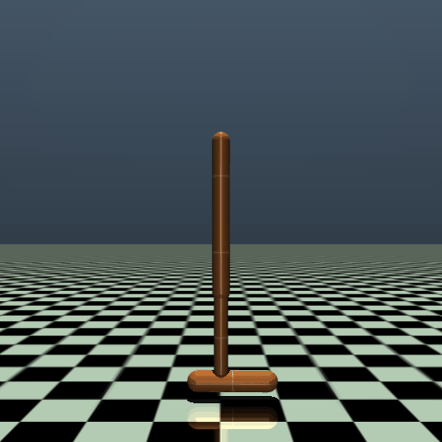
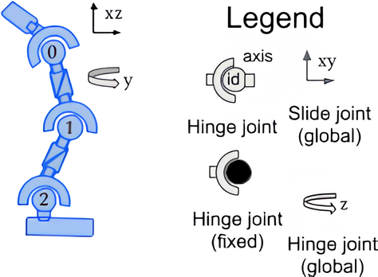


Hopper
$$z$$
$$x$$
Observation
nominal
residual
Index | Observation | Mean | Range
0 | root_z | z-coordinate of the torso (height of hopper) | -[inf, inf]
1 | root_y | angle of the torso | -[inf, inf]
2 | thigh_joint | angle of the thigh joint | -[inf, inf]
3 | leg_joint | angle of the leg joint | -[inf, inf]
4 | foot_joint | angle of the foot joint | -[inf, inf]
5 | root_vx | velocity of the x-coordinate of the torso | -[inf, inf]
6 | root_vz | velocity of the z-coordinate of the torso | -[inf, inf]
7 | root_vy | angular velocity of the angle of the torso | -[inf, inf]
8 | thigh_joint_v | angular velocity of the thigh hinge | -[inf, inf]
9 | leg_joint_v | angular velocity of the leg hinge | -[inf, inf]
10 | foot_joint_v | angular velocity of the foot hinge | -[inf, inf]
슬라이드 2에서 정의된 가동 범위의 값만 들어옴
Torso
0: Thigh joint
Thigh
1: Leg joint
실제 코드에서는 [–10, 10]으로 clipping
Leg
2: Foot joint
Foot

Slide 3

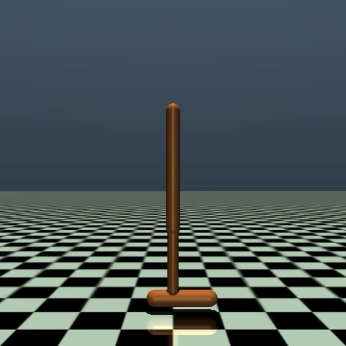
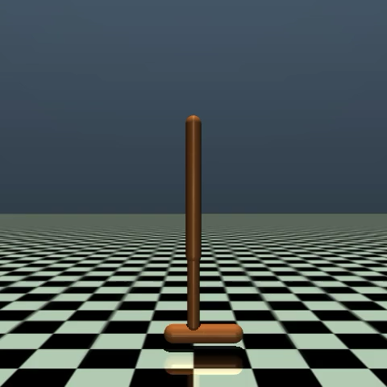

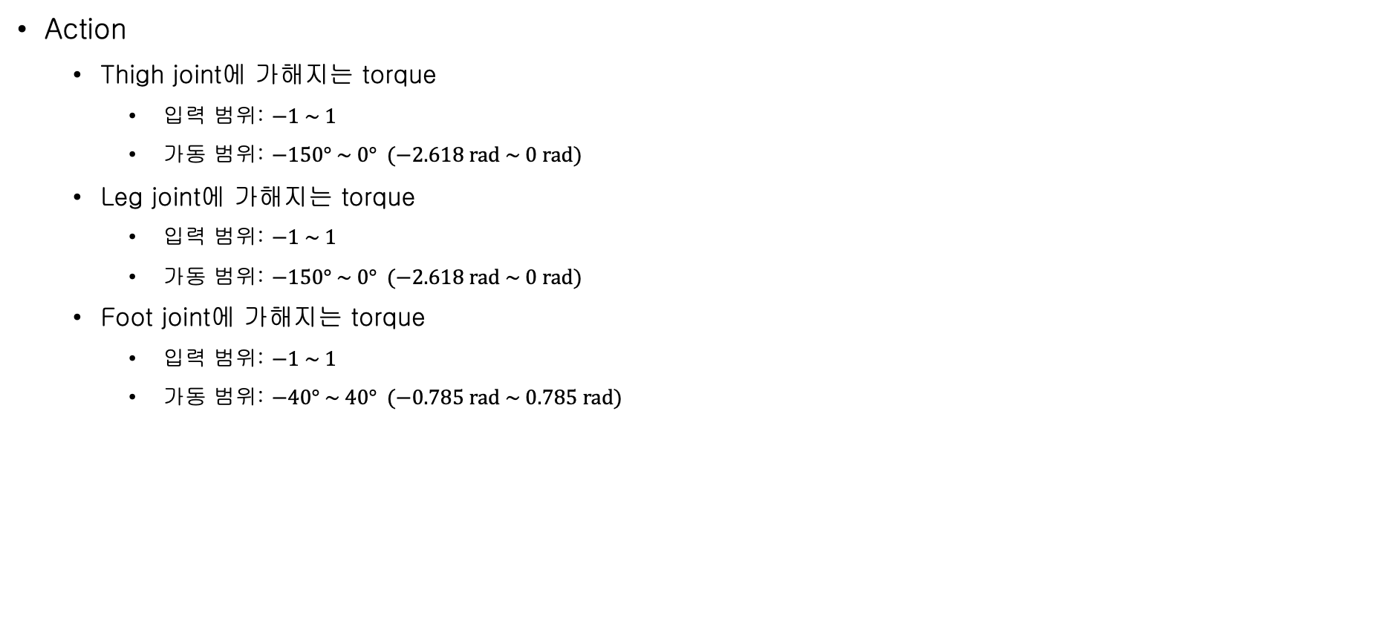
Hopper
Torso
0: Thigh joint
Thigh
Action
  Thigh joint에 가해지는 torque
    입력 범위: $−1 \sim 1$
    가동 범위: $−150° \sim 0° (−2.618 rad \sim 0 rad)$
  Leg joint에 가해지는 torque
    입력 범위: $−1 \sim 1$
    가동 범위: $−150° \sim 0° (−2.618 rad \sim 0 rad)$
  Foot joint에 가해지는 torque
    입력 범위: $−1 \sim 1$
    가동 범위: $−40° \sim 40° (−0.785 rad \sim 0.785 rad)$
1: Leg joint
Leg
2: Foot joint
Foot
action 입력: 설정된 gear 값(200)을 곱해 torque를 계산 -> MuJoCo 시뮬레이션에 적용
각가속도 계산: forward dynamics 계산을 통해 각가속도 계산
각속도 계산: Semi-implicit Euler + 4th-order Runge-Kutta
초기 상태: 모든 joint의 제어 입력이 0
다른 joint들의 제어 입력은 모두 0으로 고정한 상태로 실험 joint의 제어 입력을 -1로 설정
이후 다시 +1로 설정
Thigh joint
Leg joint
Foot joint

Slide 4
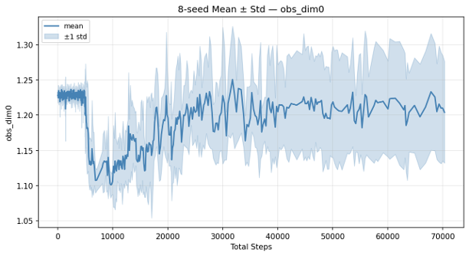
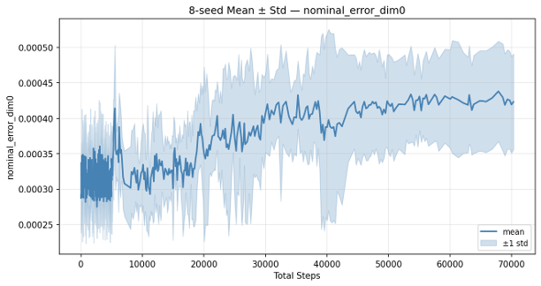

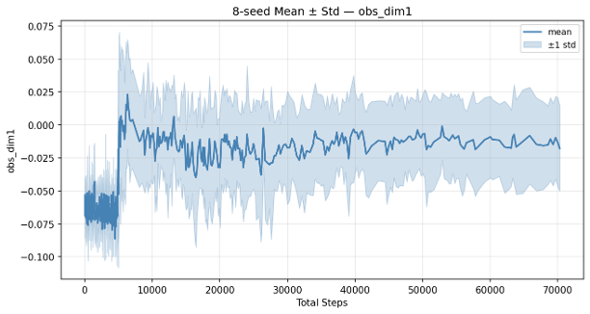
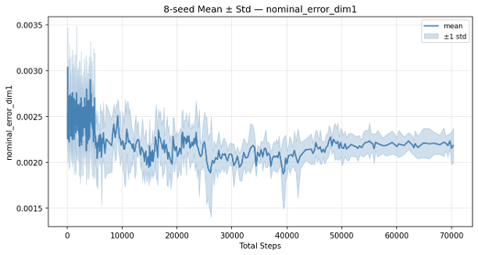

Observation
nominal
residual
0: z-coordinate of the torso
nominal error
residual error
1: angle of the torso
nominal error
residual error

Slide 5
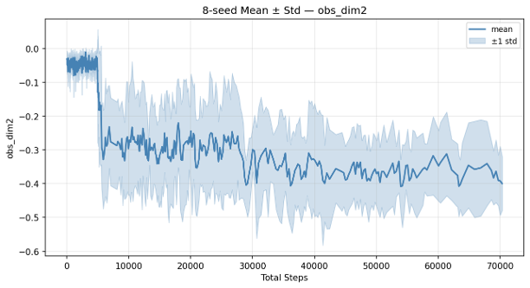
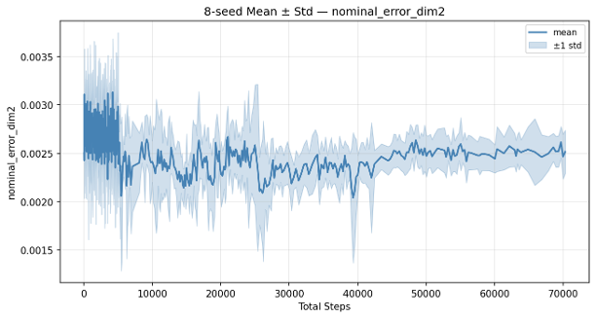

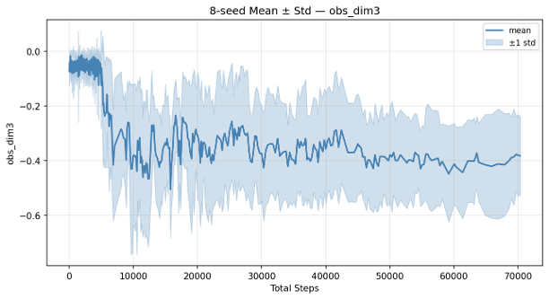
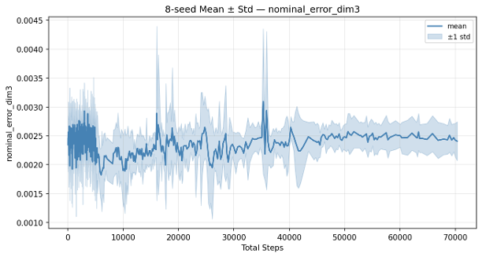

Observation
nominal
residual
2: angle of the thigh joint
nominal error
residual error
3: angle of the leg joint
nominal error
residual error

Slide 6
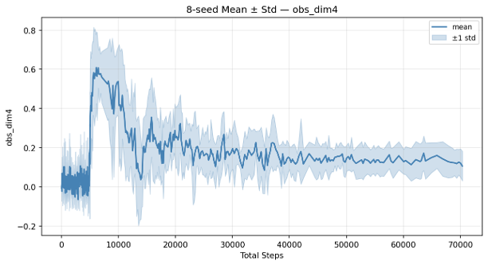
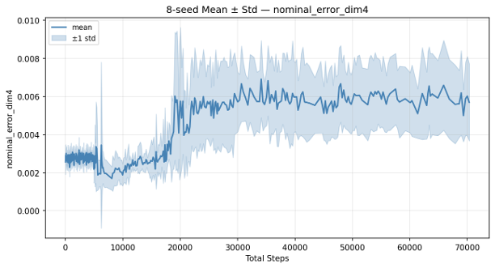

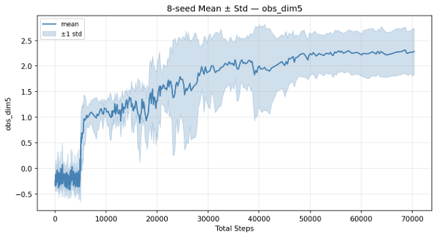
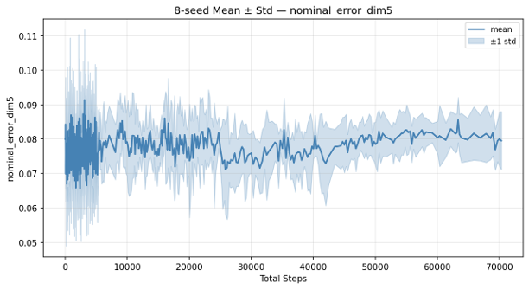
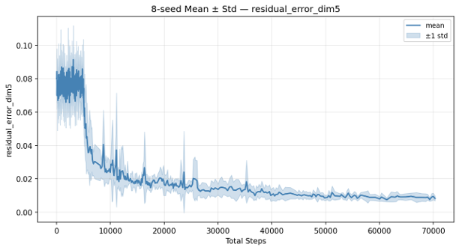
Observation
nominal
residual
4: angle of the foot joint
nominal error
residual error
5: velocity of the x-coordinate of the torso
nominal error
residual error

Slide 7
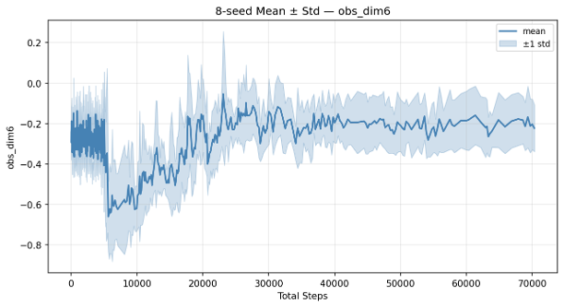
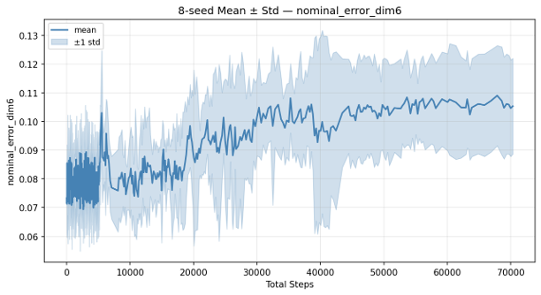
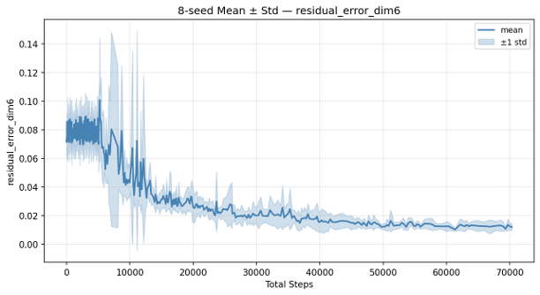
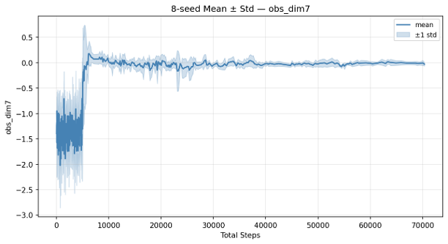
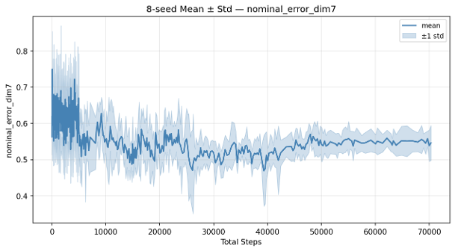
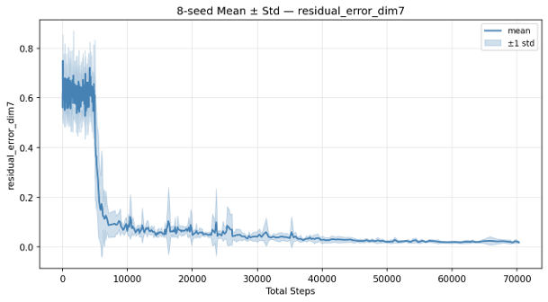
Observation
nominal
residual
6: velocity of the z-coordinate of the torso
nominal error
residual error
7: angular velocity of the angle of the torso
nominal error
residual error

Slide 8
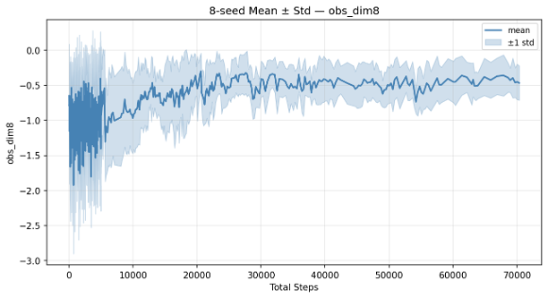
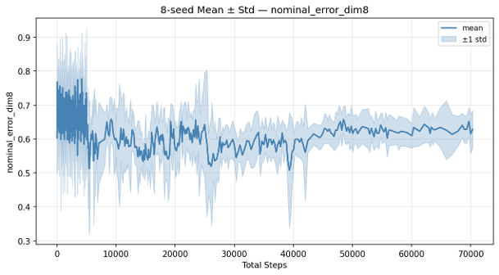
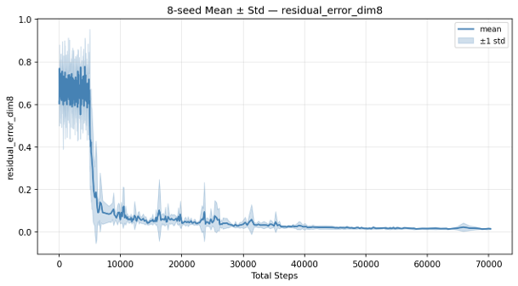
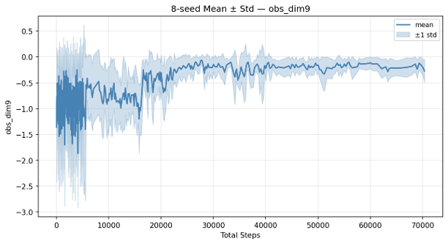
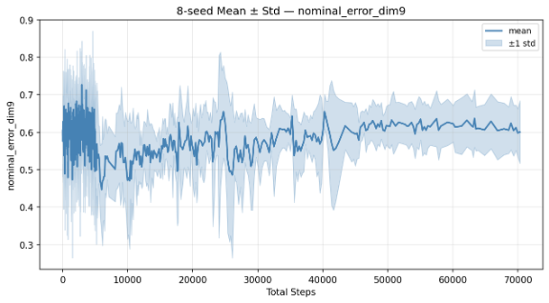
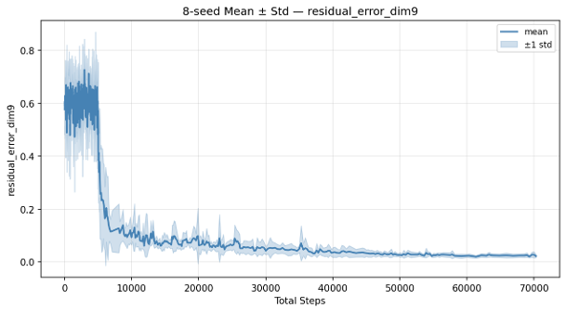
Observation
nominal
residual
8: angular velocity of the thigh hinge
nominal error
residual error
9: angular velocity of the leg hinge
nominal error
residual error

Slide 9
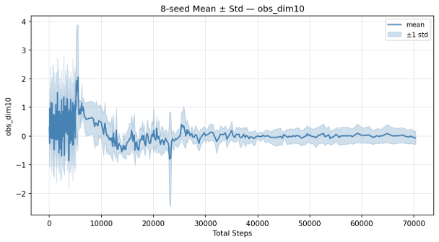
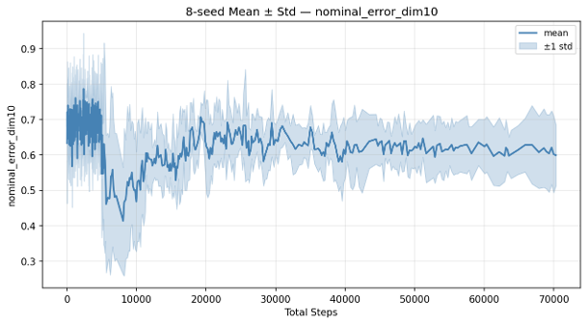
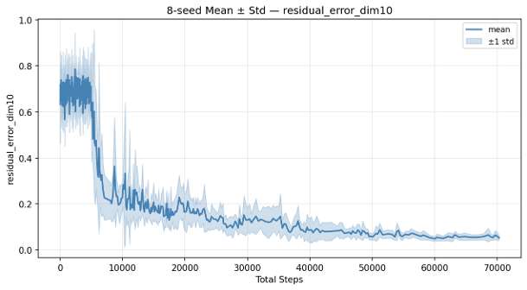
Observation
nominal
residual
10: angular velocity of the foot hinge
nominal error
residual error

Slide 10



Test Video

